Slide 1
Open Source OS (Linux)
برمجة مفتوحة المصدر
Lecture 6
By Scholar PhD. Edris Hussain Mohammed |karary university
Department of Information systems
Edruis.hessan@gmail.com
2025

Slide 2

Lecture 6 Topics:
Inter-Process Communication
Package Management Overview
Software Packages
Package File Name Format
dpkg Command
Problems with dpkg
Installing Packages using apt command
Un-Installing Packages using apt
Software Repository

Slide 3
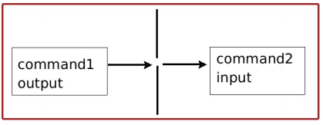
Inter-Process Communication
7.2 Pipes: it is a mechanism in which Producer process writes data to the pipe, after which the consumer process reads data from the pipe in first-in-first-out queue.
• Piping Examples
  ls –l | more
  ps –e | grep root
7.3 Sockets: Allows pairs of processes on the same system or different
systems to exchange data by establishing direct bidirectional
communication channels
• Socket Types:
  – Stream sockets: Implement the traditional client/server model
  and they use TCP for reliable communication
  – Datagram sockets: Faster, but less reliable communication and use
  UDP packets

Slide 4
Package Management Overview
Package Management is A way to distribute software and configuration
Eg.
  – .tar.gz or tgz (Slackware)
  – .rpm (Red Hat, Fedora, SUSE, …)
  – .deb (Debian, Ubuntu)
• Meta-package manager
  – Locate packages on the Internet, download, install and analyze
  inter-package dependencies. eg.
  • yum (rpm)
  • apt-get (deb and rpm)

Slide 5
Software Packages
Build from the source code: Need to download the software and compile it to generate the binaries/libraries
Install a pre-prepared Package: The software may be pre-prepared in a package that is ready for installation and it is Only applicable to official releases
Packages depend on the used Linux distribution
Debian based distributions (like Ubuntu) they come in .deb
Red Hat based distributions (like Fedora) they come in .rpm
A Software Package is an archive of files that contains, The binary files to be installed (previously built) , configuration files, Meta data about the package (including a list of dependencies) , and installation scripts
Packages are available,
    Individually on internal sites (a package file with extension .deb or .rpm)
  Among a group within common repositories (collection of packages)
Tools and package format is dependent on the Linux distribution (we will focus on Ubuntu based distributions)

Slide 6
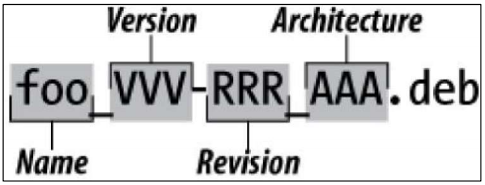
Package File Name Format
The package name normally contains words separated by hyphens
The package version is normally composed of 3 numbers separated by dots, in the format major.minor.patch
The Architecture is normally to state what kind of processor this
• package is targeting
Examples are:
  gedit-common_3.10.4-0ubuntu4_i386.deb
  gnome-user-guide_3.8.2-1_all.deb
  Libfile-copy-recursive-perl_0.38-1_all.deb
  2048-qt_0.1.6-1_amd64.deb

Slide 7
dpkg Command
• To install .deb file, we use the tool dpkg which can be used as below
dpkg -i <package file>
• To remove the packge we use
dpkg -r <package name>
• If we have a package named “package name”,
• To list all installed packages
dpkg -l
• To show all files inside a package
dpkg -L <package name>
• To determine if a package is installed or not
dpkg --status <package name>
• To find out which package installed a certain file
dpkg --search <file name>
• To fix dpkg problems run
dpkg --configure –a

Slide 8
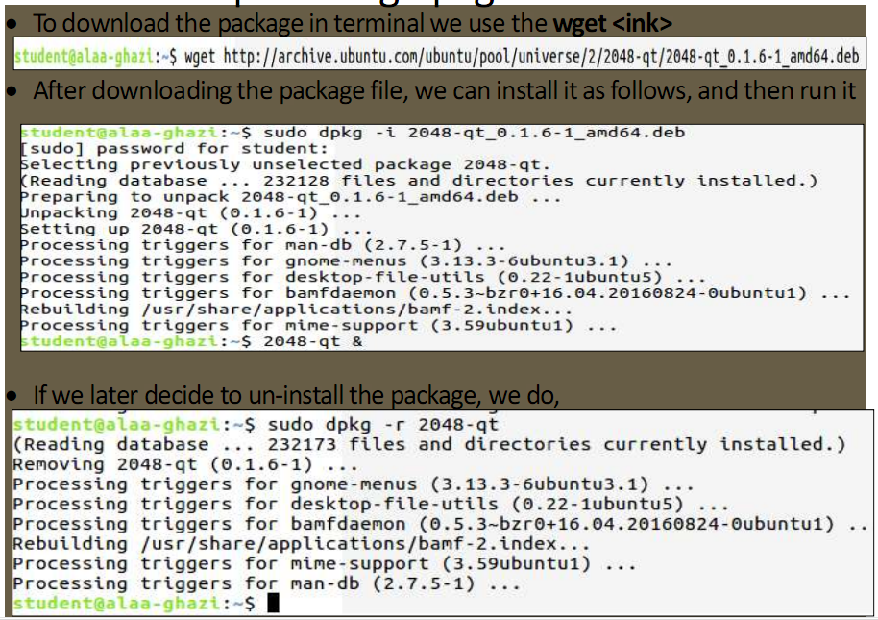
Example: using dpkg command

Slide 9
The end

